Slide 1
Mobile Application
CIOB Connect – 1 year on
Tim Cawood
Head of Digital

Slide 2
Overview

Slide 3
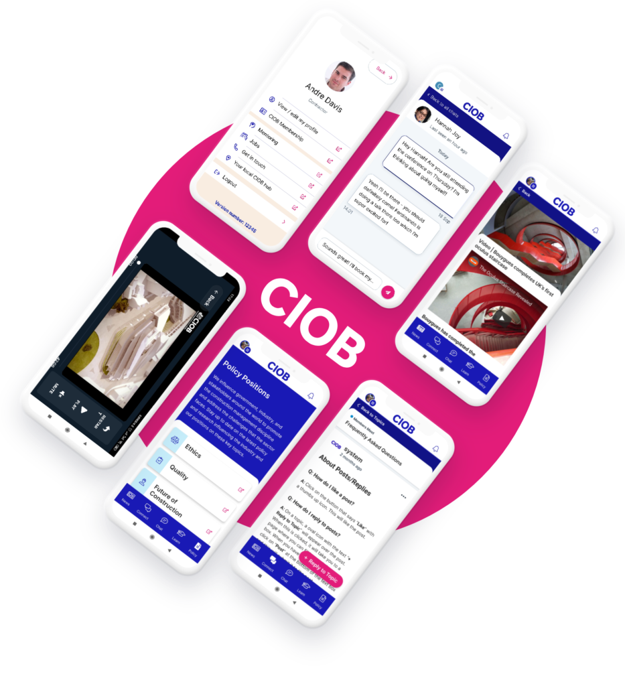
CIOB Connect
Overview
Launched in July 2021 with the goals of improving connectivity between CIOB products and services whilst adding value to members and driving young people to the CIOB.
The mobile application is a platform as a service (PaaS) solution developed using MemCloud to deliver additional functionality whilst creating a bespoke experience for our members.

Slide 4
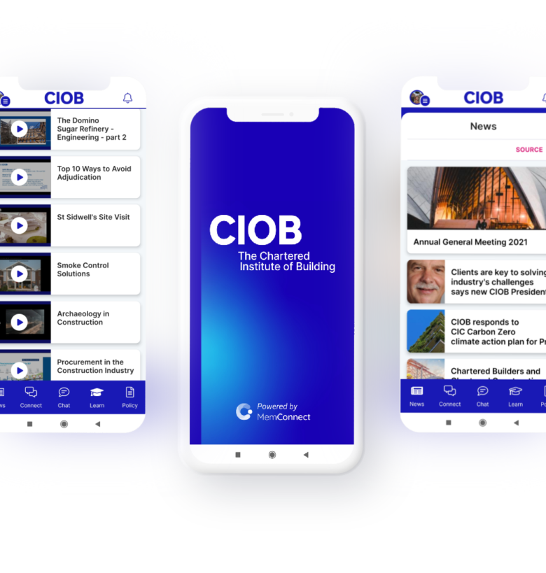
Development
Overview
A full review of functionality was conducted with members, staff and students including representatives of boards and Novus groups.
A core set of products was agreed with these groups based on user feedback to select key features over the course of 6 workshops.
Design and features and product demonstrations were shared throughout over several months.

Slide 5
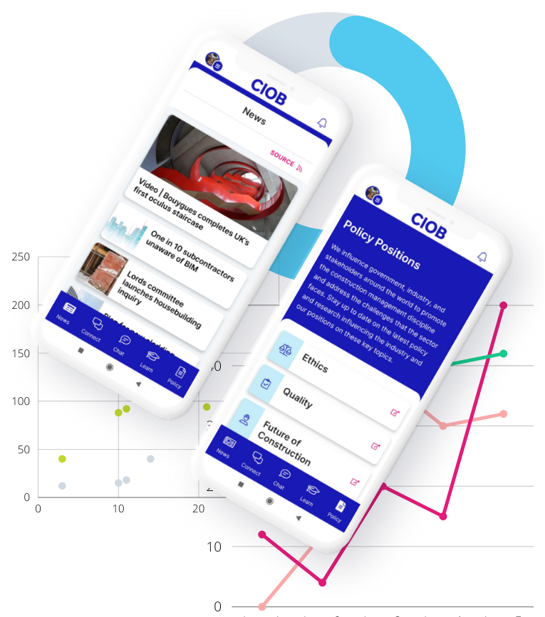
Investment
Overview
The CIOB Connect App was delivered at a cost of £55,000, this provided:
Bespoke design and development
Integration with magazines and Academy
Core functionality from MemCloud
An ongoing licensing cost is required of £32,000 which includes all core developments and features and product support.
A further investment of £25,000 has been marked for 2022 to integrate events, members directory and to add further user experience improvements

Slide 6
Timeline
Overview
July 2021
- Launched at Members' Forum
October 2021
- Community Engagement Campaign
January 2022
- First phase of development
July 2022
Events Integration
June 2022
Members Forum on App
April 2022
- CIOB Assist
Community Manager joining CIOB

Slide 7
Installations and Engagement
Tracking growth in user numbers

Slide 8
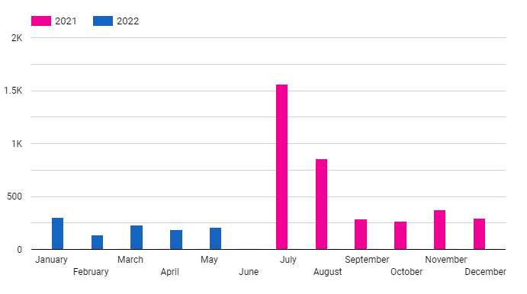
Overview
Installations
A total of 4706 unique installations as of 31 May 2022
Goal: 10% of active members downloaded currently reached 11.2%, our revised goal for 2022 – 2023 is to reach 16.2% of membership.
Benchmarked against the Royal College of Optometrists

Slide 9
Acquisition
Installations
In the first 6 months iOS accounted for approx. 66% of all downloads
Android has been our largest growth audience in the last 6 months.
50.4% of downloads are coming through CIOB channels with 49.6% coming through app stores.

Slide 10
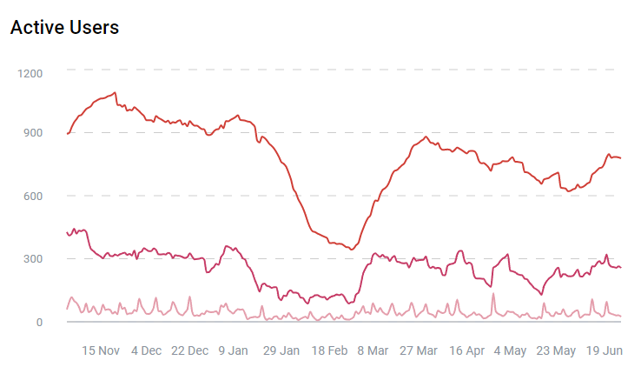
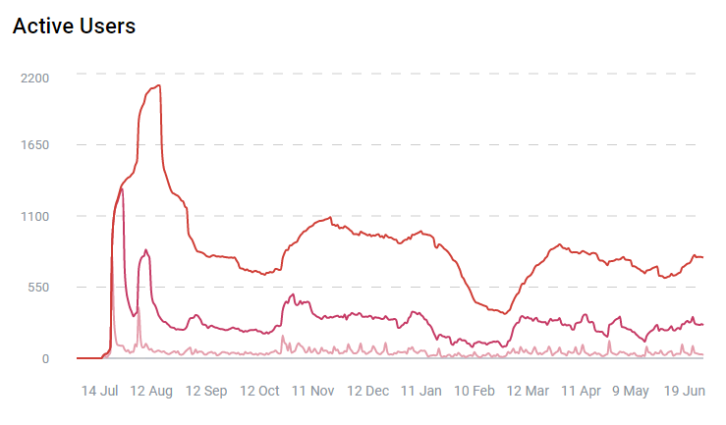
Overview
Analytics Error
Engagement
3rd Party Access Issue
Engagement for apps and communities is tracked with Monthly Active Users (MAU), our goal is to reach 2,000 MAU.
We have had several issues with tracking MAU in the last ½ year with a dip in February caused by an update causing engagement not to be tracked; not affecting users and a 3rd party issue in May affecting logins which did affect users.
6 month overview
1 year overview

Slide 11
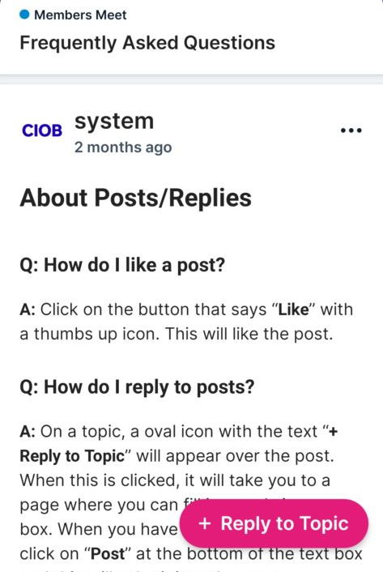
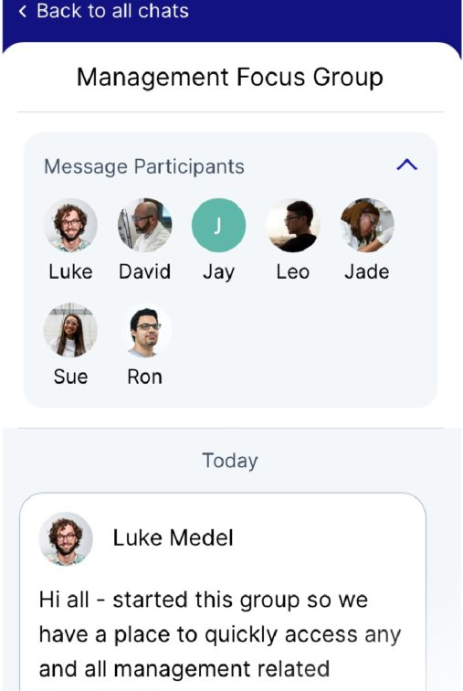
Our approach
Engagement
Engagement is our key focus for the mobile application and will be key focus of several work streams:
Inspiring Tomorrows Leaders (ITL), an initial group for champions has been established and communities for ITL members are being setup to support the strategy
Hub Trails, launching with some hubs for feedback and improvements of features to support hubs
Community Executive, beginning in July to support community development and growth.

Slide 12
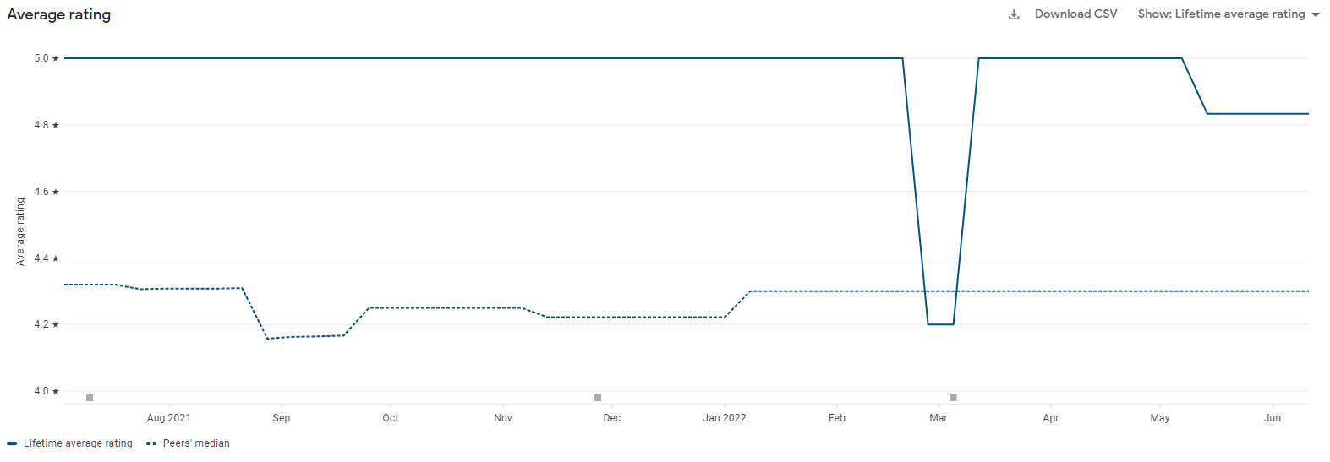
Reviews and Feedback
We have achieved a 4.833 Star average review, with all reviews responded to by CIOB staff.
Feedback has been collated from the ITL group, responded to and factored in to our development roadmap.
Further engagement is planned with members to create a ‘product board’ to allow engaged members the opportunity to steer future improvements.
Engagement
Lifetime Average
Customer review, responded to and converted into 5*

Slide 13
Roadmap
Future development

Slide 14
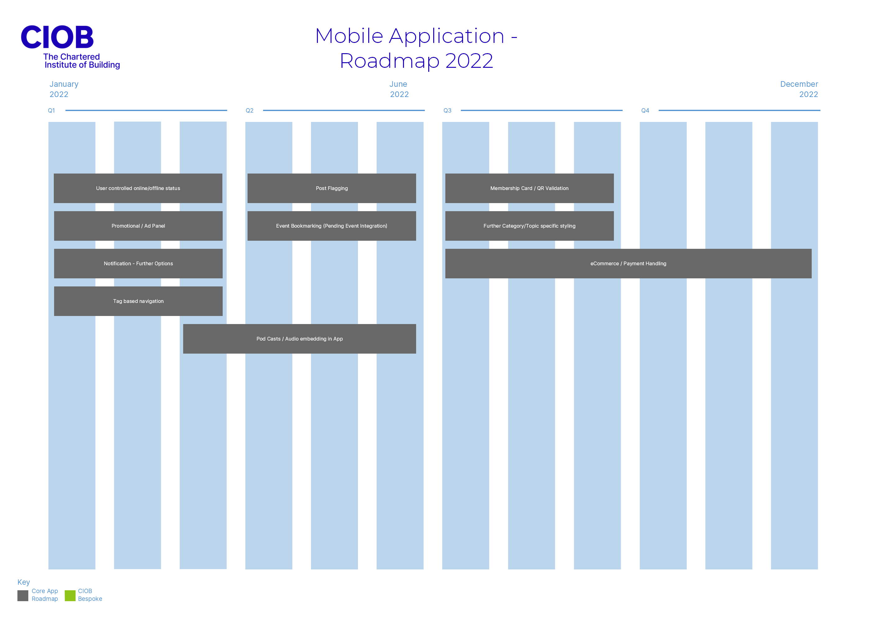
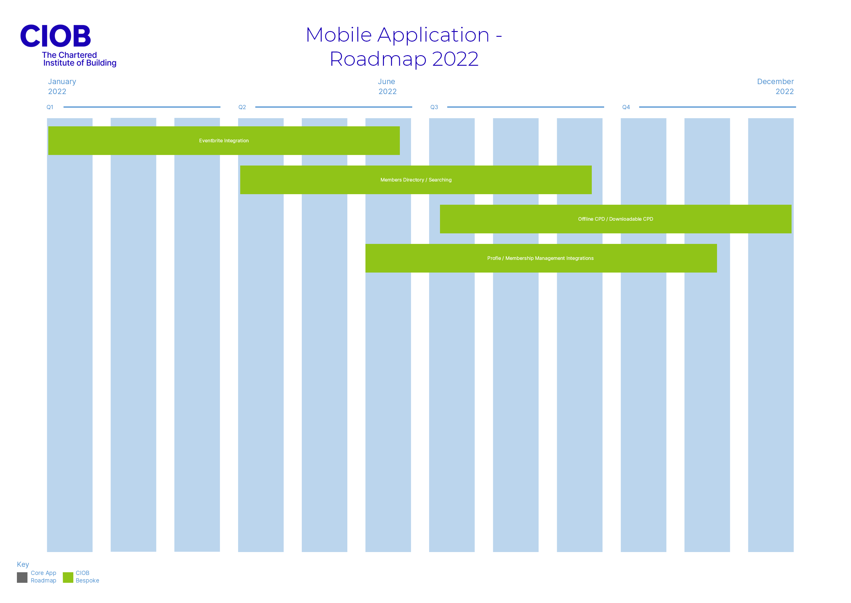
Planned Developments
Roadmap
Due to utilising the Platform as a Service (PaaS) approach the core service has a series of planned developments throughout 2022.
Bespoke developments are in 2022 for the CIOB are tracking 1 month behind schedule and include:
Event integration
Members Directory
Profile Management
Offline CPD

Slide 17
Thank You

Slide 18
Thank You

Slide 19
Page title style here
Page subtitle style here
PowerPoint presentation body copy style goes here sit amet
Massa vitae tortor condimentum lacinia quis. Orci nulla pellen
Tesque dignissim enim sit amet venenatis necusis tincidunt

Slide 20
Page title style here
Page subtitle style here
PowerPoint presentation body copy style goes here sit amet
Massa vitae tortor condimentum lacinia quis. Orci nulla pellen
Tesque dignissim enim sit amet venenatis necusis tincid

Slide 21
Page title style here
Page subtitle style here
PowerPoint presentation body copy style goes here sit amet
enim sit amet venenatis
Massa vitae tortor condimentum lacinia quis. Orci nulla pellen
enim sit amet venenatis
Tesque dignissim enim sit amet venenatis necusis tincidunt
enim sit amet venenatis

Slide 22
Page title style here
Page subtitle style here

Slide 23
Page title style here
Page subtitle style here
PowerPoint presentation body copy style goes here sit amet
enim sit amet venenatis
Massa vitae tortor condimentum lacinia quis. Orci nulla pellen
enim sit amet venenatis
Tesque dignissim enim sit amet venenatis necusis tincidunt
enim sit amet venenatis

Slide 24
“Odio ut sem nulla pharetra diam. Adipiscing elit pellentesque habitant morbi.”
Name Surname
Job title

Slide 28
“Odio ut sem nulla pharetra diam. Adipiscing elit pellentesque habitant morbi.”
Name Surname
Job title

